Slide 1
Review of UML Class Diagram

Slide 2
What are the Different Types of Relationships Among Classes?
Four types of class relationships:
  Inheritance
  Association
  Aggregation/Composition
  Dependency

Slide 3
Inheritance
Allows us to define a new class (derived class) by extending an existing class (base class).
  Represents generalization -specialization relationship.
  Allows redefinition of the existing methods (method overriding).
LibraryMember
Base Class
Faculty
Students
Staff
Derived
Classes
UnderGrad
PostGrad
Research

Slide 4
Inheritance Example
Animal
“A Dog ISA Animal”
Dog

Slide 5
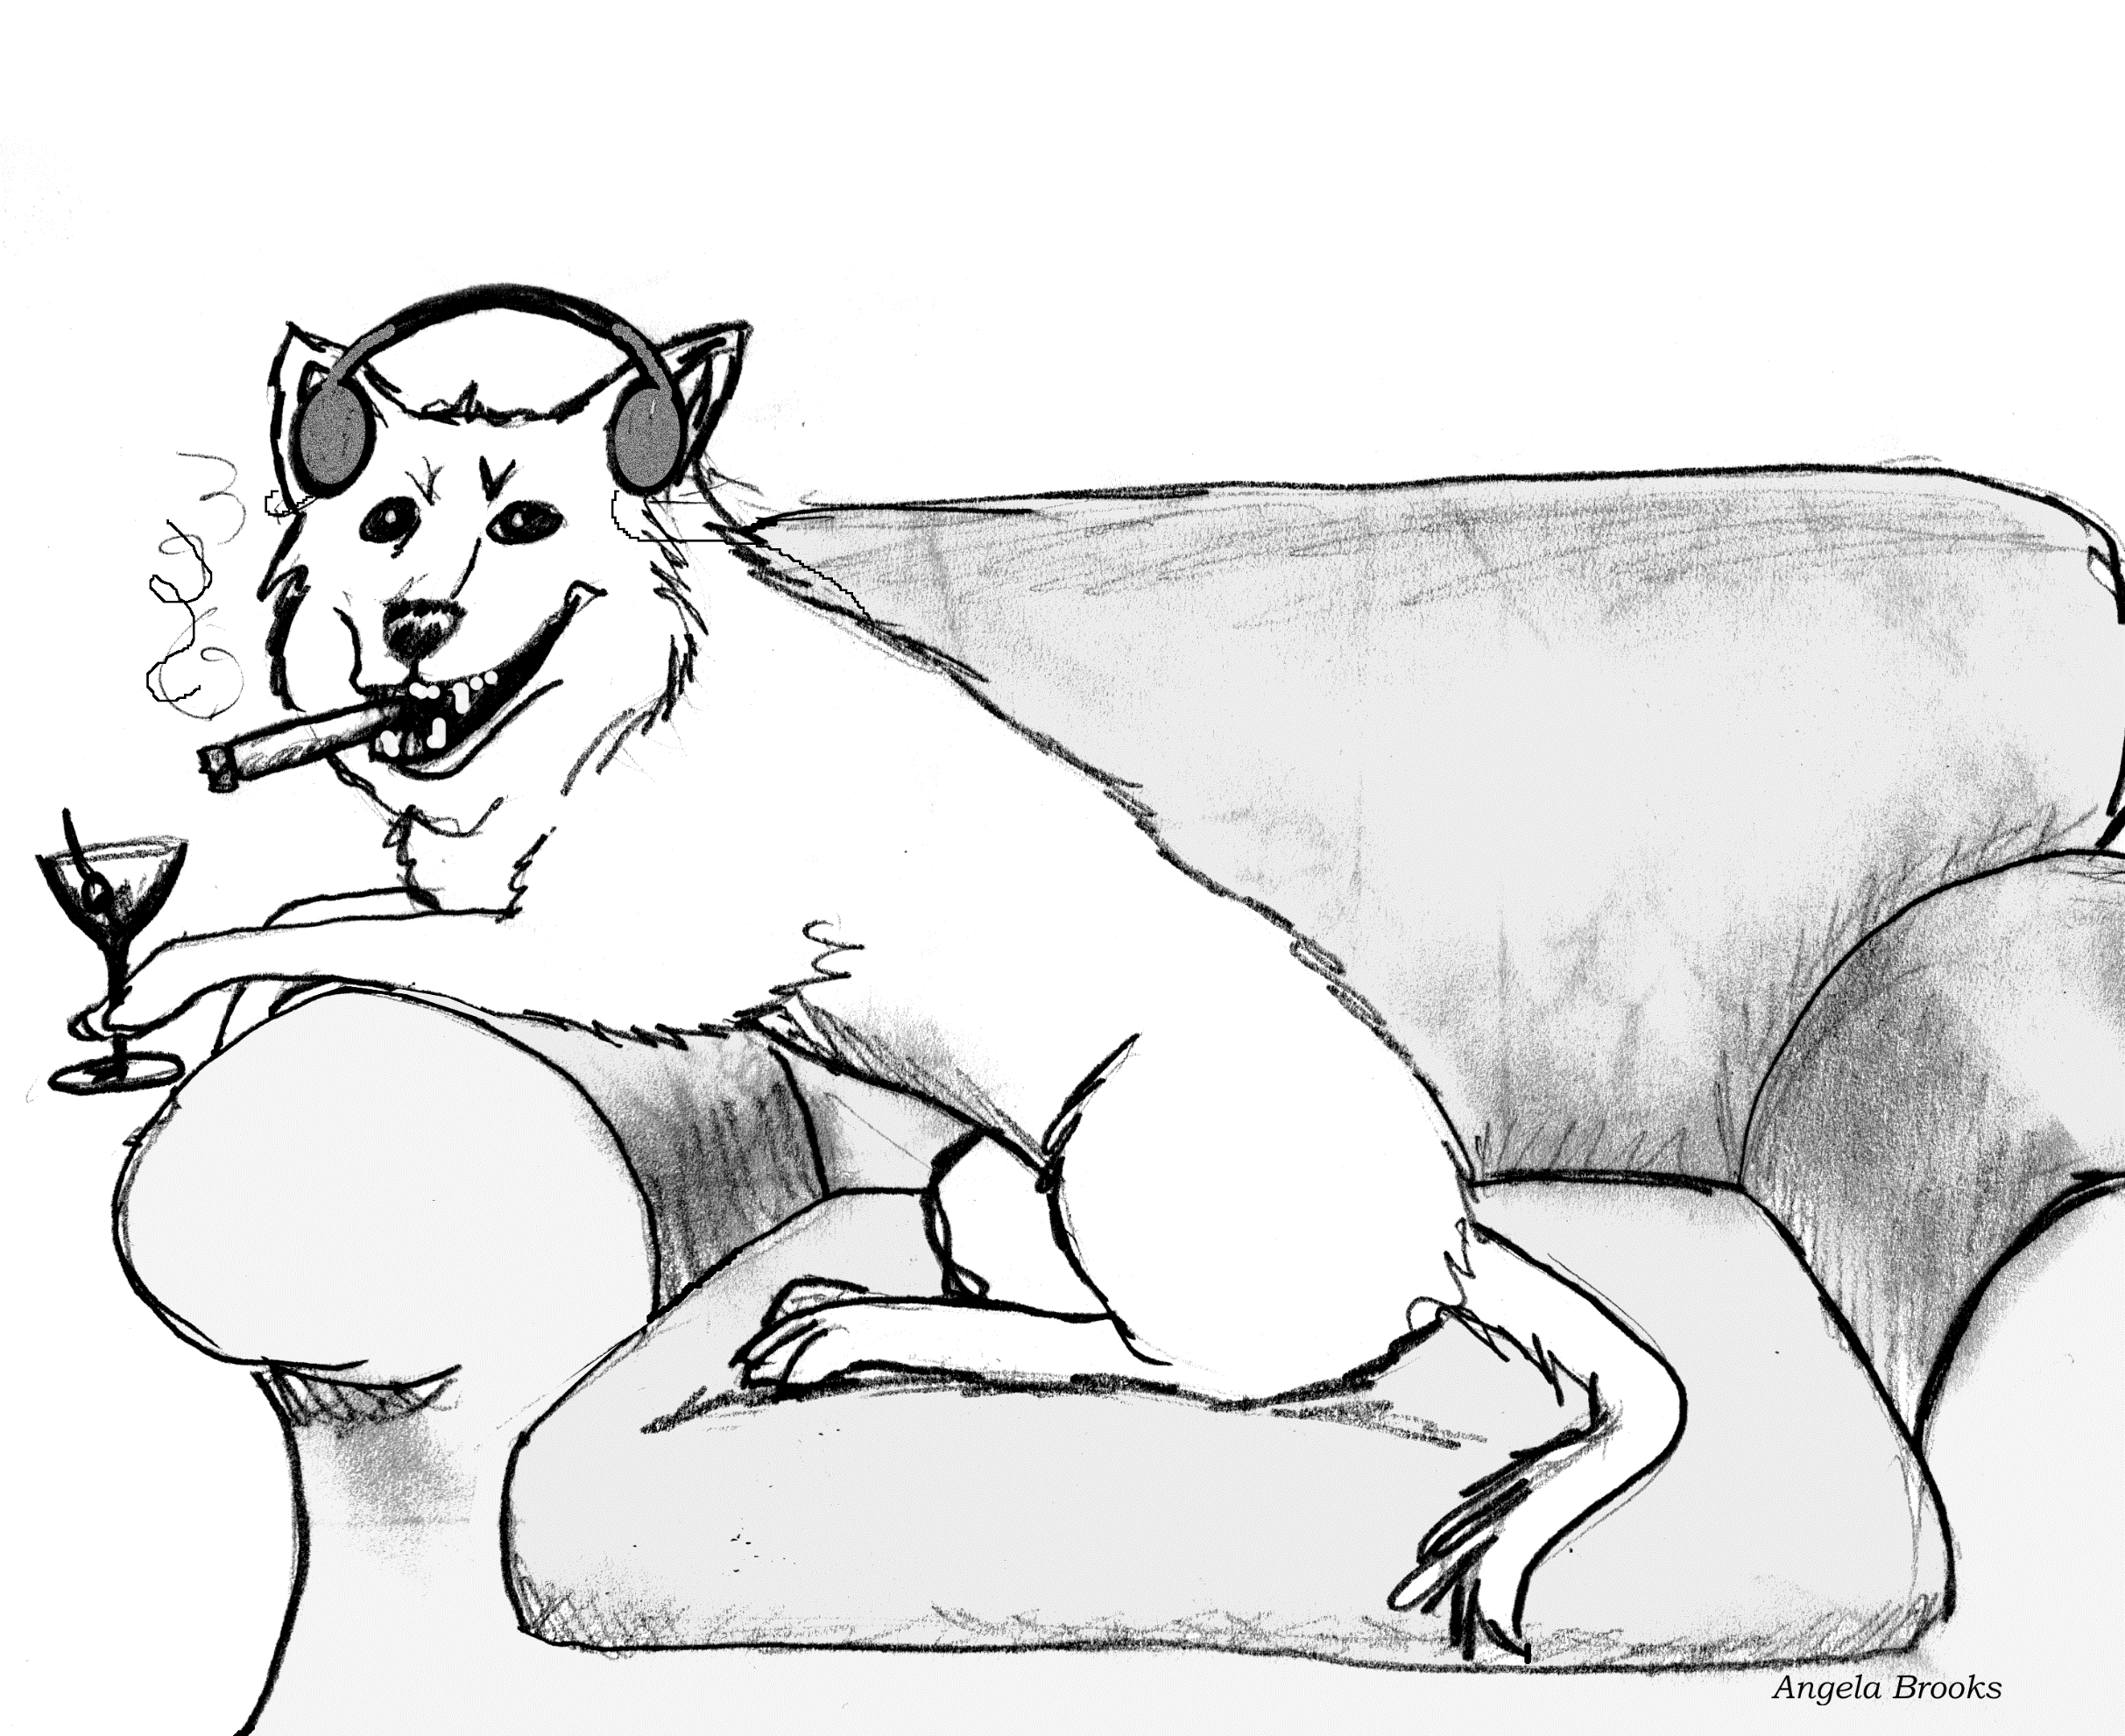
Hmmm… not really…

Slide 6
Inheritance: One More Example
Library Member
“A Student ISA Library Member”
“A Faculty ISA Library Member”
Stdent
Faculty

Slide 7
Inheritance: Semantics
Lets a subclass inherit attributes and methods of a base class.
LibraryMember
Base Class
Faculty
Students
Staff
Derived
Classes
UnderGrad
PostGrad
Research

Slide 8
Inheritance: An Alternate Representation
LibraryMember
Base Class
Faculty
Students
Staff
Derived
Classes
UnderGrad
PostGrad
Research

Slide 9
Inheritance Example
Library
Book
issuable
reference
Issuable
Single Volume
Book
Issuable
BookSet
Reference
Single Volume
Book
Reference
BookSet
Discriminator: allows to group subclasses into
clusters that correspond to a semantic category.

Slide 10
Multiple Inheritance
LibraryMember
Base Class
LibraryMember
Base Class
Faculty
Students
Staff
Derived
Classes
Faculty
Students
Staff
Multiple
Inheritance
UnderGrad
PostGrad
Research
UnderGrad
PostGrad
Research

Slide 11
Multiple Inheritance: Can Cause Repeated Inheritance…
LibraryMember
Base Class
May lead to inconsistency
In C++ handled by using virtual base class
In Java handled by using Interface class
Faculty
Students
Staff
Multiple
Inheritance
UnderGrad
PostGrad
Research

Slide 12


Inheritance Implementation in Java
Inheritance is declared using the "extends" keyword
  Even when no inheritance is defined, in Java a class implicitly extends a class called Object.
class Person{
private String name;
private Date dob;
...
}
Person
- name: String
- dob: Date
class Employee extends Person{
private int employeeID;
private int salary;
private Date startDate;
...
}
Employee
- employeeID: int
- salary: int
- startDate: Date
Employee anEmployee = new Employee();

Slide 13
Objects myRectangle and myBox
Rectangle
Rectangle myRectangle = new Rectangle(5, 3);
Box myBox = new Box(6, 5, 4);
Box
length
6.0
length
5.0
myRectangle
myBox
width
3.0
width
5.0
height
4.0
Object Reference

Slide 14
More Generalization Examples…
Mammal
Quadruped
Feline
Lizard
Tiger
Lion
Puma

Slide 15
Poor Generalization
(violates “is a” or “is a kind of” heuristic)
Person
attributes
operations
Arm
Leg
Head
attributes
attributes
attributes
operations
operations
operations
Any problems?

Slide 16
Generalization - Multiple Classification
Discriminator
Doctor
Female
#3
role
Nurse
<<abstract>>
Person
Male
Gender
#1
patient
#2
Physical-
therapist
Patient
Poor Model
#2

Slide 17
Inheritance Pitfalls
Inheritance certainly promotes reuse…
Indiscriminate use can result in poor quality programs.
Base class attributes and methods visible in derived class…
  Leads to tight coupling and break of encapsulation
LibraryMember
Faculty
Students
Staff
UnderGrad
PostGrad
Research

Slide 18
Association Relationship
Enables objects to communicate with each other…
How implemented in program?
  One object must “know” the ID of the corresponding object in the association.
Usually binary:
  But in general can be n-ary.
Teacher
teaches
Course
credits
Student

Slide 19


Association – Example
In a home theatre system,
  A TV object has an association with a VCR object
    It may receive a signal from the VCR
  VCR may be associated with remote
    It may receive a signal (command) to record
1
1
VCR
1
1
Remote
TV
commands
Connected to

Slide 20
1-1 Association – Example
has
Rakesh Shukla
760901-1234
has
V. Ramesh
691205-5678
Keshab Parhi
Person
Tax_files
Person
1
1
Tax_files
has

Slide 21
Association-end Multiplicity – Example
motherOf
Bhim
motherOf
Kunti
Yudhistir
motherOf
Ambika
Arjun
Women
People
Woman
1
*
People
Mother of

Slide 22
Association: UML Syntax
Class A
role B
Class B
role A
A Person works for a Company.
Role
Person
Company
employee
employer
works for
Association Name

Slide 23
Association -- More Examples
Multiplicity: The number of objects from one class that relate with a single object in an associated class.
Library Member
_{0..5}
Book
1
borrowed by
Lion
*
eats
Human
*

Slide 24
Navigability
Key
Door
*
opens
0..5

Slide 25
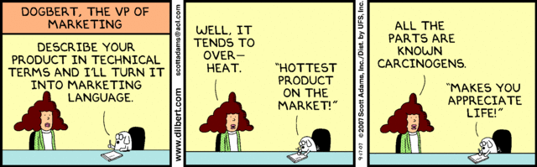

Slide 26
Association – Multiplicity
A teacher teaches 1 to 3 courses (subjects)
Each course is taught by only one teacher.
A student can take between 1 to 5 courses.
A course can have 10 to 300 students.
Teacher
1
teaches
1..3
Course
1..5
Students
takes
10..300
Notes:
1.

Slide 27
Quiz: Draw Class Diagram
A Student can take up to five Courses.
A student needs to enroll in at least one course.
Up to 300 students can enroll in a course.
An offered subject in a semester should have at least 10 registered students.
Notes:
1.

Slide 28
Student
credits
Enrolment
Course
10..300
1..5
Enrols in

Slide 29
Identify Whether Correct or Wrong
Student
credits
hasEnrolmentOf
Course
Enrols in
10..300
1..5
Student
credits
hasEnrolmentOf
Course
Enrols in
10..300
1..5
Student
credits
hasEnrolmentOf
Course
Enrols in
10..300
1..5
Student
credits
hasEnrolmentOf
Course
Enrols in
10..300
1..5

Slide 30
Quiz: Read the Diagram
Teacher
teaches
Course
1..2
0..3
*
opens
0..5
Door
Key

Slide 31
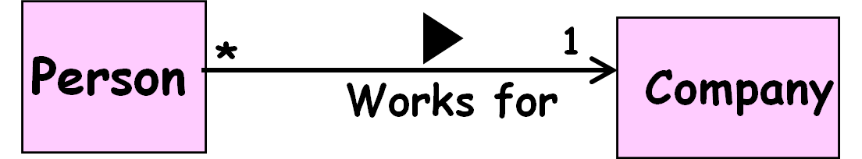
Association and Link
A link:
  An instance of an association
  Exists between two or more objects
  Dynamically created and destroyed as a run of a system proceeds
For example:
  An employee joins an organization.
  Leaves that organization and joins a new organization etc.

Slide 32
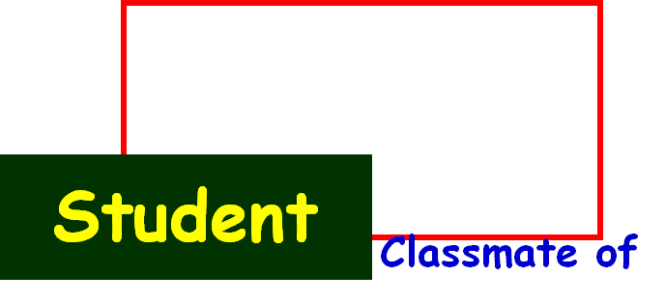
Association Relationship
A class can be associated with itself (unary association).
  Give an example?
An arrowhead used along with name:
  Indicates direction of association.
Multiplicity indicates # of instances taking part in the association.
*
*

Slide 33
Self Association: Example 0
*
Person
*
Friend of

Slide 34
Self Association: Example 1
Computer Network
Connects to
*
Computer
*

Slide 35
Computer Network: Object Diagram
Node1
Node2
Node3
Node4
Node5
Node6
Node7
Node8

Slide 36

Self Association: Example 2
Connected to
next
LinkedListNode
previous

Slide 37
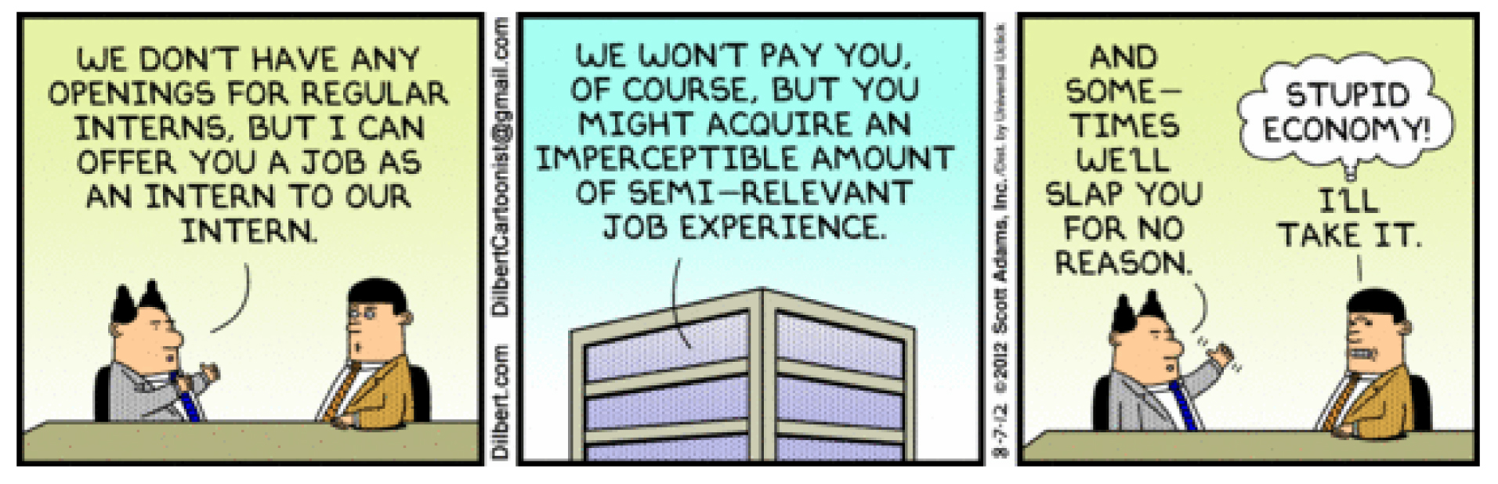

Slide 38
Reflexive Association: Example 3
Course
*
is pre-requisite for
*
has pre-requisite of

Slide 39
Implementing Association Relationship: Example 1
Store a reference variable of the associated class.
Bookname: OOSD
Author: Gamaa
ISBN: 12234434
abook
Book Reference
Book instance
Bookname:
memberName: AKK
Member Number: 412323
Member
Book
abook
1
Borrowed by
1

Slide 40
public class Member{
private Book book;
public issueBook(Book abook){
setBook(abook);
abook.setLender(this);
}
setBook(Book abook){
book=abook;
}
…
}
Member
Book
1
Borrowed
by
1

Slide 41
public class Book{
private Member member;
setLender(Member aLender){
member=aLender;
}
…
}
Book
Member
1
1
Borrowed
by

Slide 42
Naming Association Attribute
The association attribute name is derived from:
  Role names, if present
  If not present, name of the class to which it is associated
Member
1
Borrowed
by
1
Book

Slide 43

Association Implementation: Example 2
Student
credit
Enrolment
Course
1..300
enrols
1..5
Class Student {
Course Enrolment[5];
…
}
Class Course {
Student credit[300];
…
}

